Slide 1
Neural Methods for Urban Analytics
Urban Analytics Summer School
Bill Howe

Slide 2
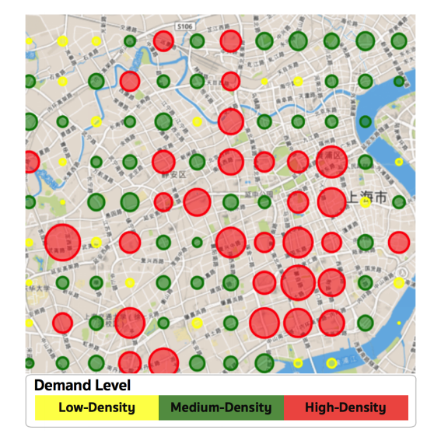
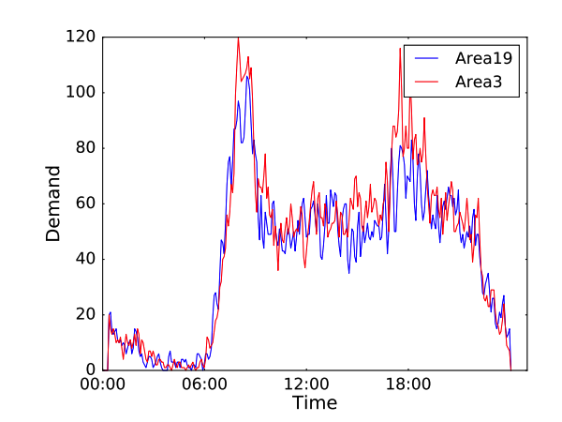
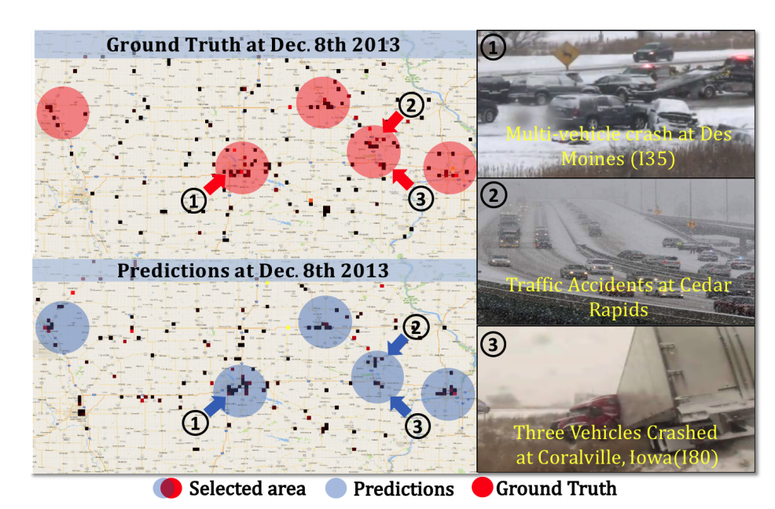
Machine learning applications in urban mobility
Bikeshare demand prediction for bike redistribution.
(Pan et al., 2018)
Ride-hailing demand prediction (Wang et al., 2017)
Traffic accident prediction
(Yuan et al., 2018)
Notes:
Take bikeshare as an example, people without smart phones are not able to access the services. Underestimation of bike demand for these groups may result in insufficient bike supply to them, which can produce a feedback loop: racial and income disparities are misinterpreted by the model as lack of demand, reinforcing reduced access to services.

Slide 3
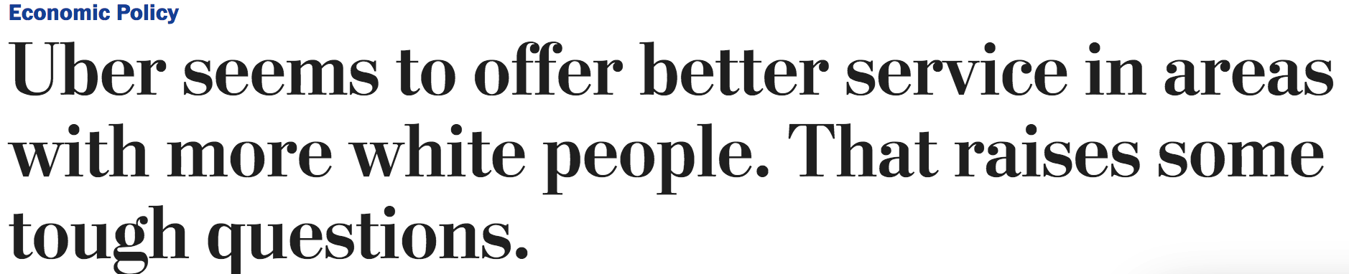
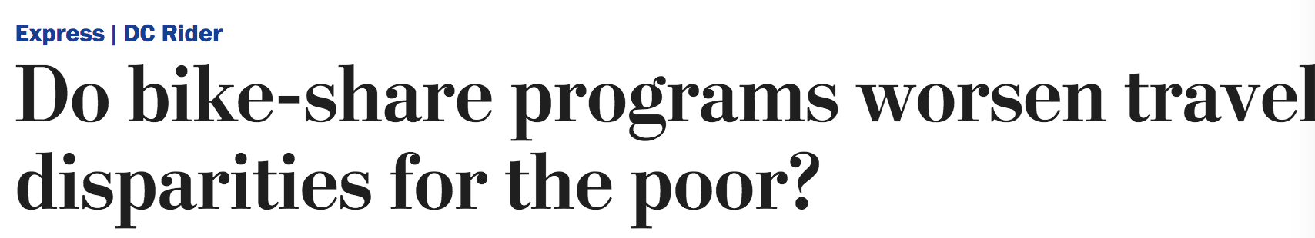
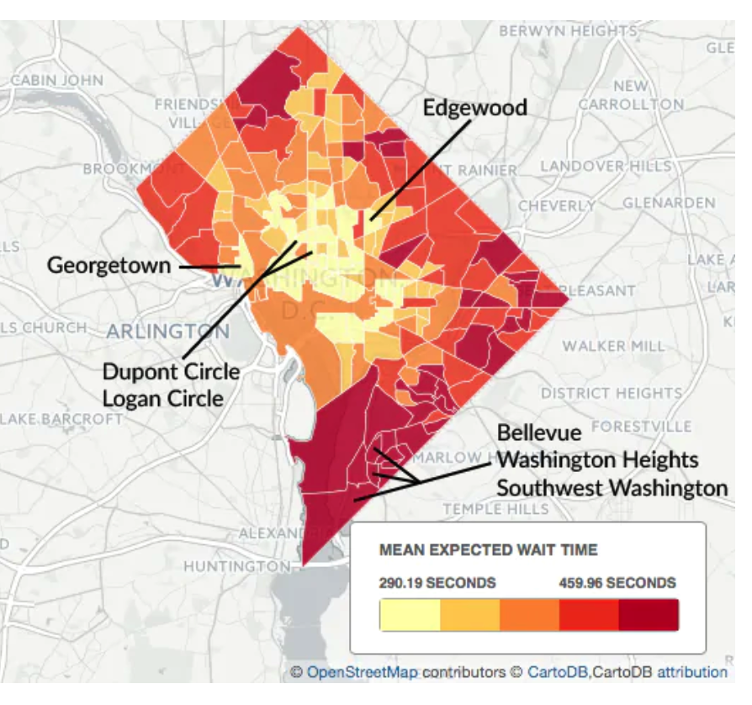
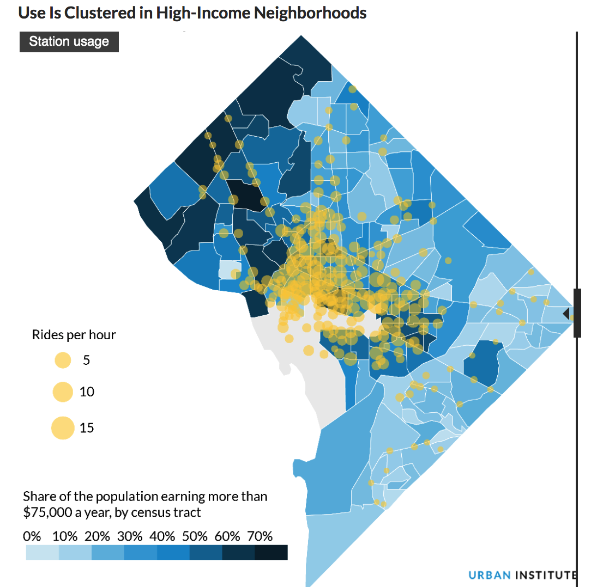
Mobility services may discriminate against certain demographic groups
Wait times are shorter in the center of the District and longer in the periphery
Use is clustered in high income neighborhoods
https://www.washingtonpost.com/news/wonk/wp/2016/03/10/uber-seems-to-offer-better-service-in-areas-with-more-white-people-that-raises-some-tough-questions/?utm_term=.f2460b236f4f
https://www.washingtonpost.com/express/2019/03/05/do-bikeshare-programs-worsen-travel-disparities-poor/?utm_term=.fe53c50af35d
Notes:
In fact, a number of transportation equity studies showed that algorithms or human beings that distribute app-based mobility services may discriminate against certain groups[cite]. For example, influenced by Uber’s pricing algorithm, neighborhoods with more white people experienced higher levels of service quality. For this reason, there is a need to incorporate equity into data-driven algorithms to achieve equitable resource distribution by design.
Moreover, according to a latest study on bikeshare equity, the usage of bikeshare system is concentrated in high-income and less diverse neighborhoods. Mobility dataset like this may contain biases. So there is also the need to remove biases from mobility datasets so that the biases do not propagate, if the datasets are about to be released for public use or will be used in machine learning models for future prediction.
At the same time, the emergent field of fairness in machine learning predominantly focuses on cases such as loan distribution, college admission, predictive policing, and online advertising. There is a dearth of research on fairness-aware approaches for urban mobility scenarios.

Slide 4
Transportation Equity
Equity of new mobility services
Fairness
Fair Machine Learning
Measuring fairness
Removing bias from algorithm
Urban Mobility
Machine Learning
?
Fairness-aware Machine Learning for Urban Mobility
Urban Data Science
Deep learning methods for Spatio-temporal prediction
Notes:
My research sits in the intersection or fairness, urban mobility, and machine learning, that is fairness-aware machine learning methods for urban mobility. This new research direction brings together the core methodologies from spatio-temporal machine learning and fair machine learning, and is examined in the context of transportation equity.
The rest of my talk will focus on these three fields. First, I will talk about how to make accurate predictions for urban mobility tasks using deep learning. Then I will introduce transportation equity with a focus on equity of new mobility services. Lastly, I will talk about how to make fair predictions.

Slide 5
Urban Data Science
Spatio-temporal prediction methods
Naïve models (e.g., Historical Average)
Time series methods (e.g., Autoregressive and Moving Average Models)
Kalman filters
Conventional machine learning ( e.g., Random Forest)
Advantages of Deep Learning
Exceptional predictive power due to its ability to learn non-linear associations
Ability to learn spatial or temporal dependencies through specific network structures
Automatic extraction of features from input data
End-to-end learning of powerful feature representations
(Nagy, Attila M., and Vilmos Simon, 2018)
Notes:
Predicting urban events relies on spatio-temporal methods.

Slide 6
Urban Data Science
Deep learning for spatio-temporal (ST) prediction
Recurrent neural networks (RNN)
-> Model time series
Convolutional neural networks (CNN)
-> Model spatial dependencies
Spatio-temporal Neural Networks (STNN)
ConvLSTM
3D CNN
-> Model spatio-temporal dependencies
Notes:
Deep learning advantages

Slide 7
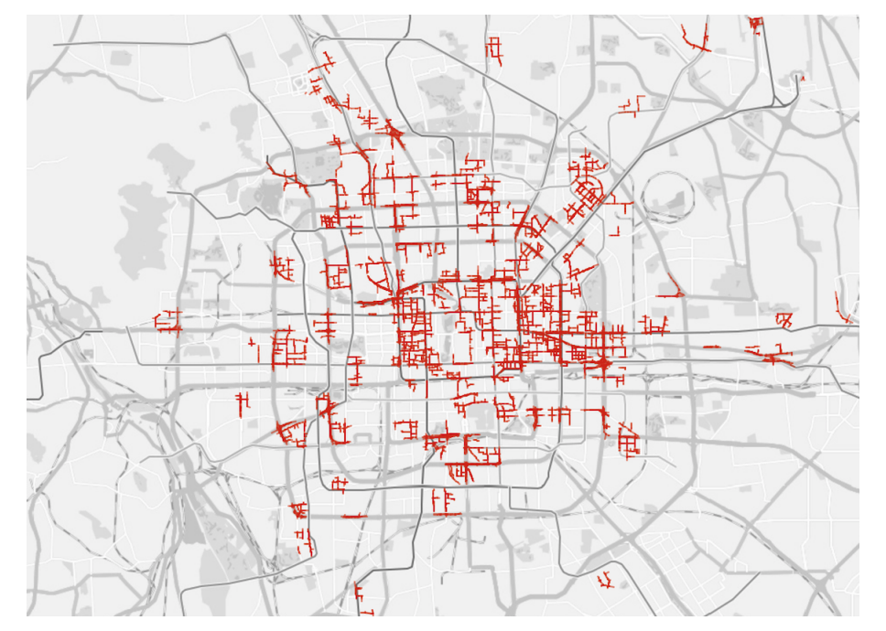
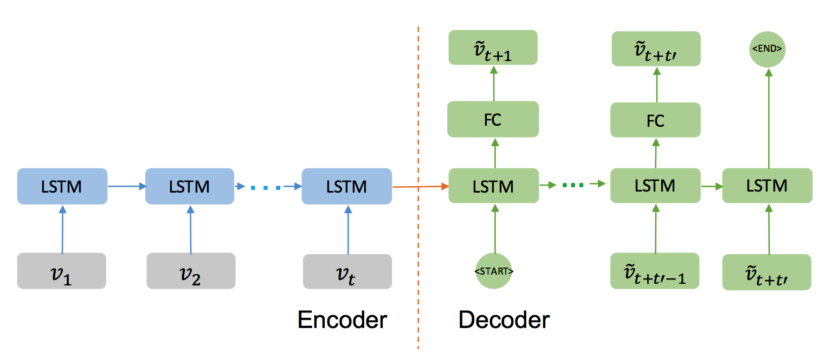
Urban Data Science: RNN-based ST models
Traffic speed prediction
Predictions: {vt+1 , vt+2 ,. . . , vt+t’ }
Spatial
Relation (v1)
Spatial
Relation (v2)
Spatial
Relation (vt)
concat
concat
concat
Spatial distribution of the road segments used in predictions
Input sequence traffic speed {v1 , v2 , . . . , vt }
(Liao et al., 2018)
Notes:
Suitable for spatially discrete data such as road segments.

Slide 8
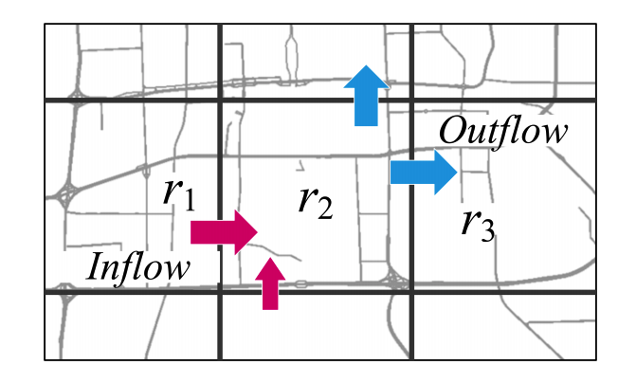
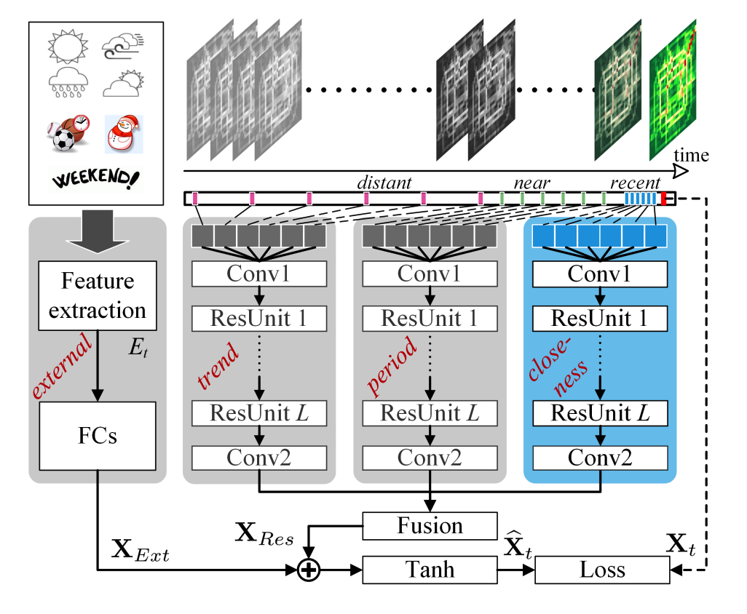
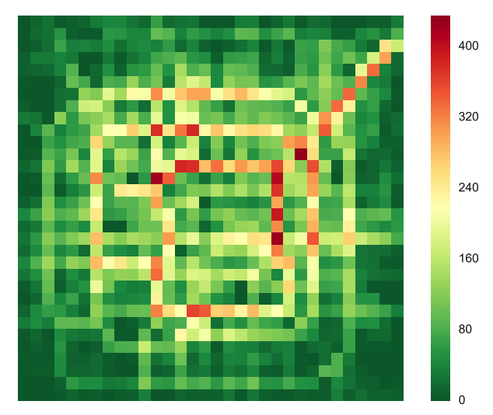
Urban Data Science: CNN-based ST models
Predicting citywide crowd flows
Inflow and outflow
Inflow matrix
(Zhang et al., 2018)

Slide 9
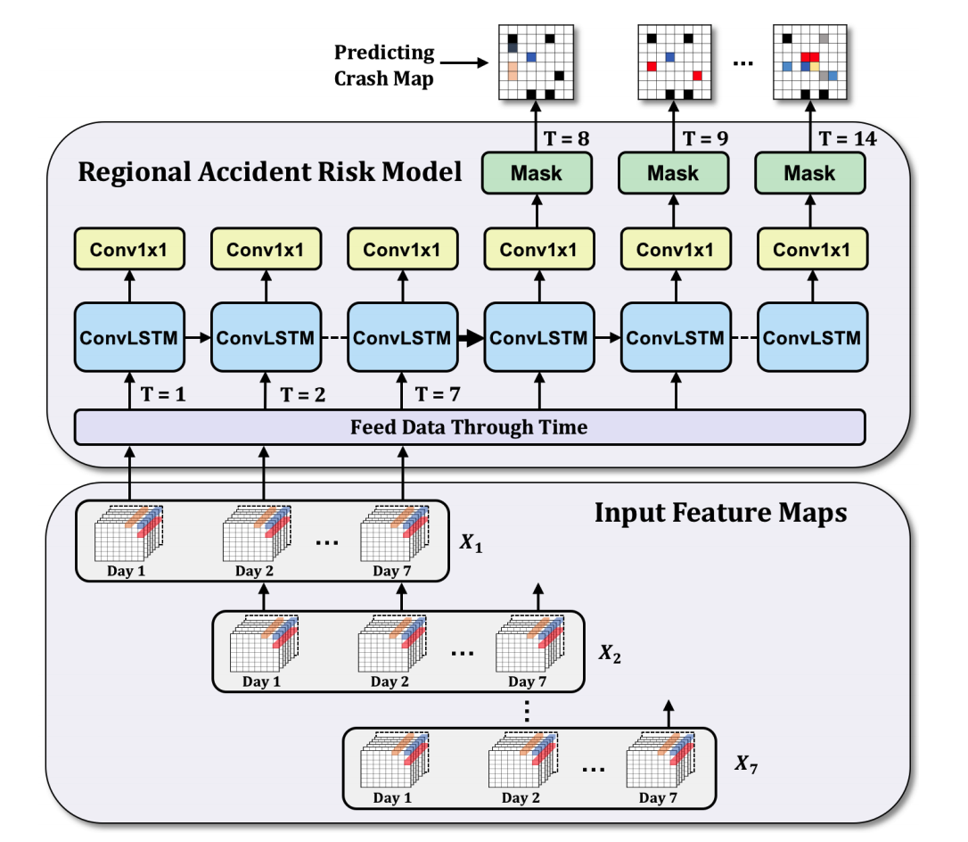
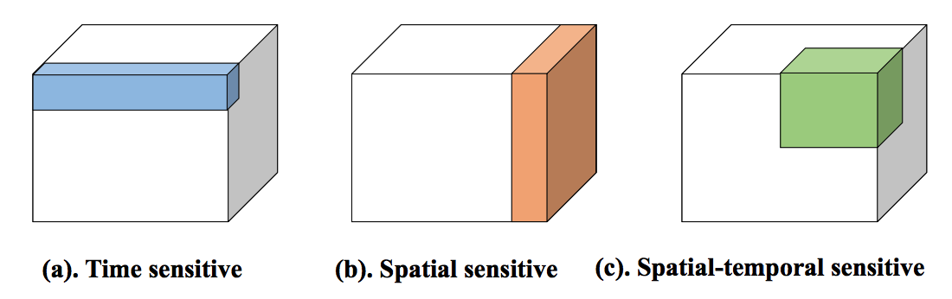
Urban Data Science: Spatio-temporal Neural Network
ConvLSTM
3D CNN
1D convolution
2D convolution
3D convolution
Illustration of perception region of different convolution operations.
(Yuan et al., 2018)
(Shen et al., 2018)
Notes:
3D CNN is another structure that can model spatio-temporal dependencies. 2D CNN uses 2D convolution operations to compute features from spatial dimensions. 3D convolution can preserve temporal information as the multiple contiguous frames of input are connected by the 3rd dimension of the
filters, therefore the output is another 3D tensor containing temporal information.
In fact, 1D convolution can summarize information along temporal dimension, 2D convolution can summarize information in 2D space, and 3D convolution can learn information from 3D space.

Slide 10
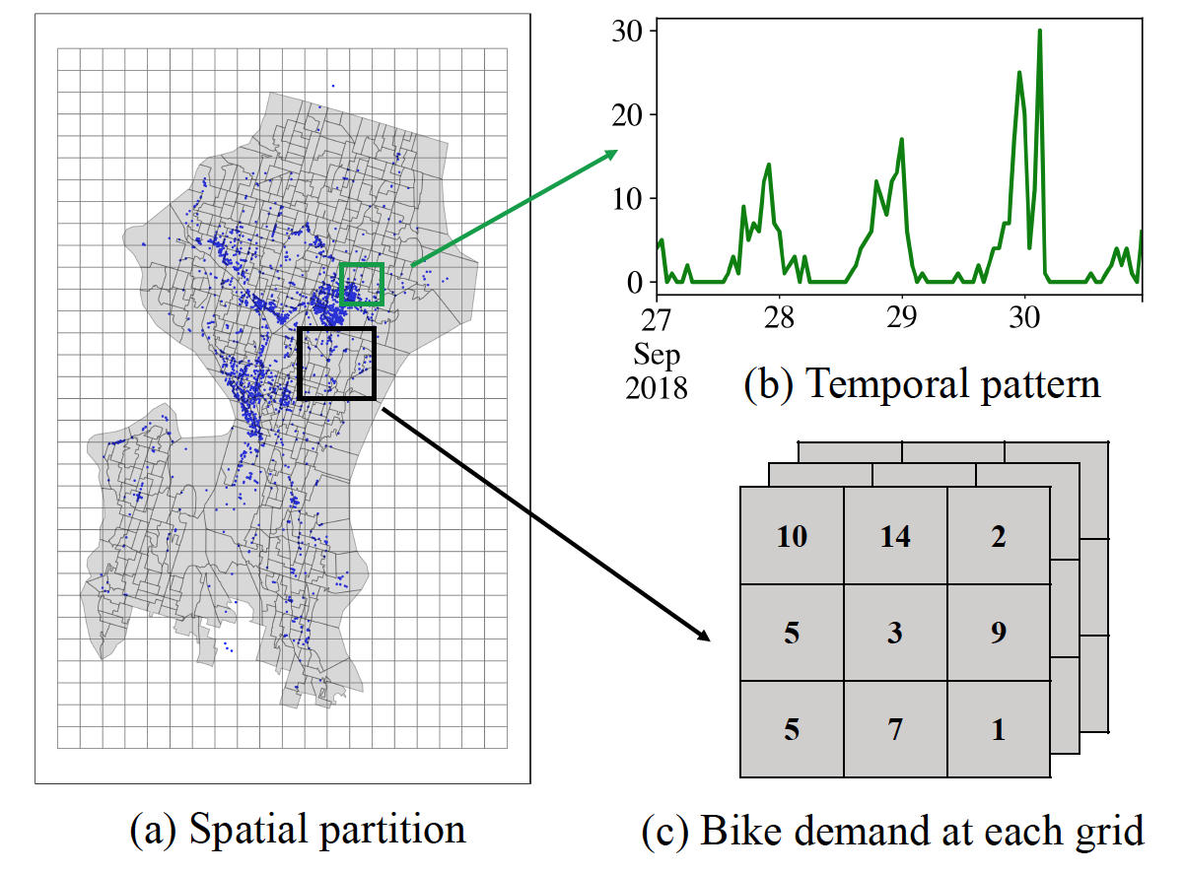
Urban Data Science: Spatio-temporal Neural Network
Dockless bikeshare demand prediction
Forecast hourly demand from 1km by 1km regions based on demand of last 7 days.
This information is useful for bike operators to design bike reposition strategy. A fine-grained prediction is more desired than a coarse-grained (daily demand in a neighborhood) when it comes to action in real-time.
Data preprocessing
Notes:
We have looked at RNN-based, CNN-based, and STNN models. Each of them has its own advantages and weaknesses and they can be combined with various data fusion techniques. The adoption of deep learning is still new in urban mobility. it is not well-understood which architectures or combination of techniques are superior than others.
To compare different methods, I will present a case study of predicting dockless bikeshare demand using these methods. The prediction task is to forecast hourly demand for bikes for Seattle based on the demand of last 7 days

Slide 11
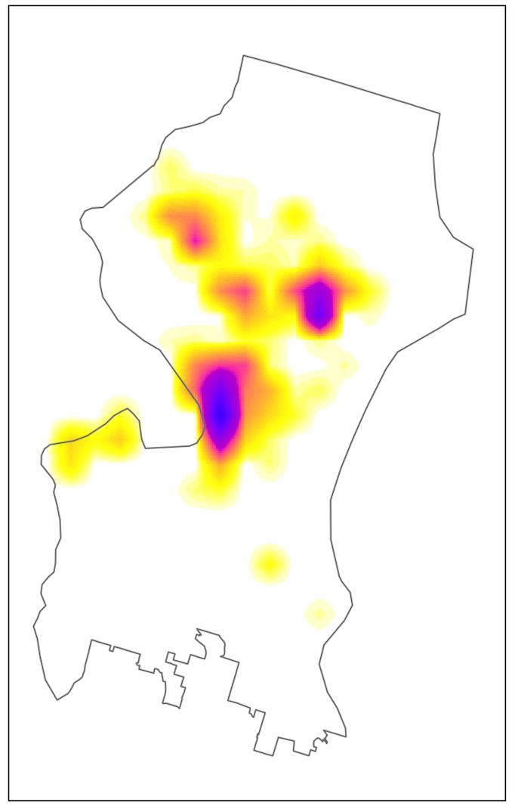
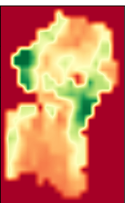
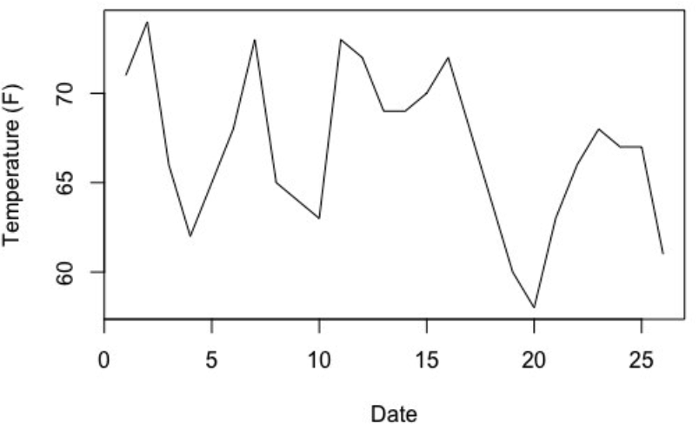
Time
3D input
e.g, bikeshare demand, crime incidence, etc.
Use 1D, 2D, and 3D urban features to predict bikeshare demand in an end-to-end network. m, n, k are the number of 3D, 2D, and 1D features, respectively.
3D convolutional layers
2D features
e.g, steep slope and bikelanes
[H, W, 1]
[H , W , time steps , m]
Fused feature maps
Prediction
2D convolutional layers
2D convolutional layers
Concat
[H, W, 3]
[H, W, 1]
[H ,W ,n]
[H, W, 1]
1D convolutional layers
Duplicate
1D features
e.g., temperature
[1,1,1]
[Time steps, k]
[H, W, 1]
Notes:
I designed a network based on 1D, 2D, and 3D convolutional layers. I use 3D information such as historical bikeshare demand, 2D input such as elevation and bike lanes, and 1D features such as temperature to train separate sub models and then fuse them together to make the final prediction.

Slide 12
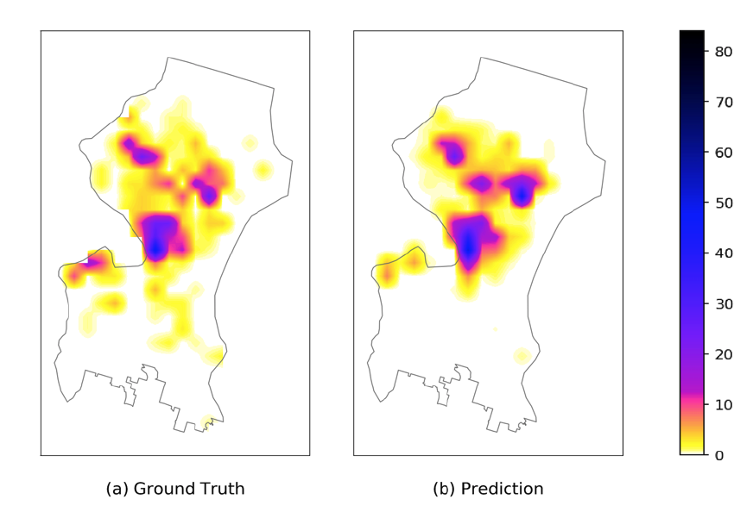
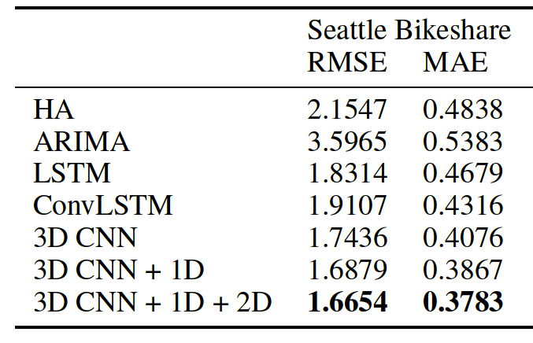
Urban Data Science: Spatio-temporal Neural Network
Accuracy comparison of different methods
Ground truth and prediction of Seattle bikeshare demand at 2018-10-06 16:00:00.
Notes:
The results showed that 3D CNN based model outperforms others. LSTM achieves better accuracy than HA and ARIMA, but suffers from inability to learn spatial context. ConvLSTM performs the best among the baselines due to its capability of learning both spatial and temporal information. 3D CNN outperforms ConvLSTM since the 3D CNN architecture is more powerful in terms of capturing strong local spatio-temporal correlations. Furthermore, the incorporation of 1D and 2D features improves accuracy.

Slide 13
Urban Data Science: Summary of Methods
 | Strengths | Weaknesses
RNN-based methods | Can model complex temporal dependencies Suited for spatially discrete data | Cannot capture very long time dependencies Need extra treatment to capture spatial dependencies
CNN-based methods | Can capture spatial context Suited for prediction targets that are continuous over space | Need extra treatment to capture temporal dependencies Require image-like data representation
STNN: ConvLSTM | Can learn spatio-temporal dependencies | Cannot learn very long-term dependencies Cannot learn long-range spatial context Require 3D tensor-like data representation More complex and prone to overfitting
STNN: 3D CNN | Can learn spatio-temporal dependencies | Require 3D tensor-like data representation More complex and prone to overfitting
Notes:
In summary, STNN models based on ConvLSTM or 3D CNN, generally give better prediction accuracy than RNN or CNN based models. And the use of exogenous features from urban data sources helps prediction accuracy. Nevertheless, the evaluation of various methods is dependent on the specific task and data.

Slide 14
Urban Data Science: Future Research
Improving spatial and temporal prediction accuracy
Fairness-aware prediction for urban problems
Learning reusable and sharable features for urban mobility
Learning transferable features for urban mobility
Notes:
Deep learning for mobility is still new, future research can explore many open questions.
Architectures and techniques are needed to better capture long-term spatio-temporal dependencies, address spatial heterogeneity, and deal with sparse data.

Slide 15
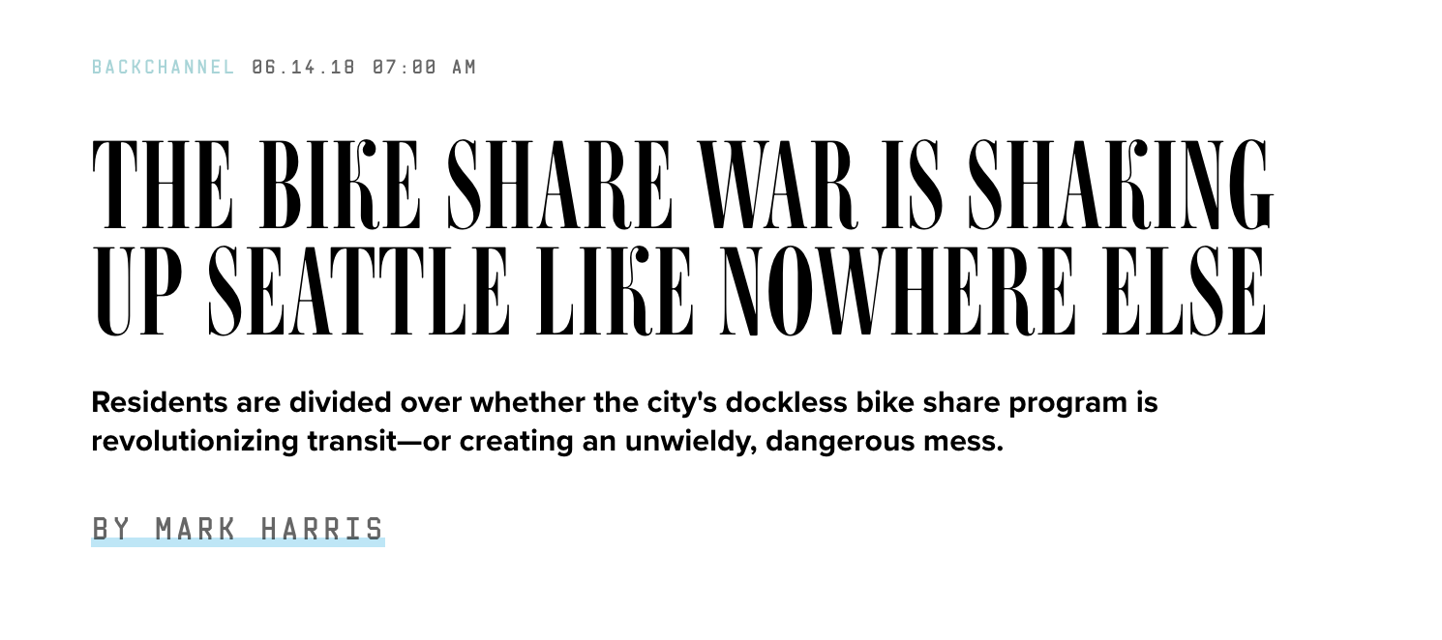
Example: Transportation Data
Example: Bike Share data
Babak Salimi
Luke Rodriguez

Slide 16
Origin-Destination Aggregated Data (“OD Data”)
Origin | Destination | Company | Gender | …
U District | U District | Bikes Inc. | Female | …
U District | U District | Bikes Inc. | Male | …
U District | U District | RideCorp | Female | …
U District | U District | RideCorp | Male | …
U District | Capitol Hill | Bikes Inc. | Female | …
Capitol Hill | U District | RideCorp | Female | …
Capitol Hill | U District | RideCorp | Male | …
…
Notes:
Running example – aggregated trips.
Julia – it would help visually to replace the count column with a bar that shows the magnitude of the count – round to a 10 and round it
Change neighborhoods to Seattle neighborhood
This way we could see the bars getting closer in the length once we mitigate

Slide 17
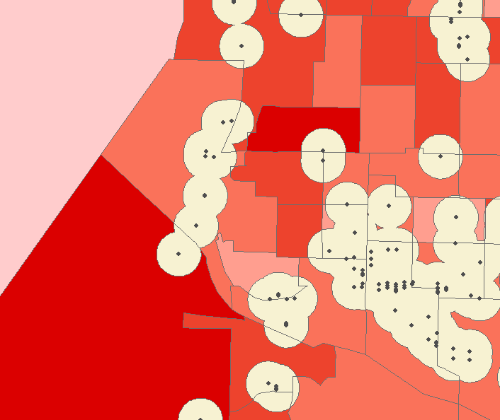
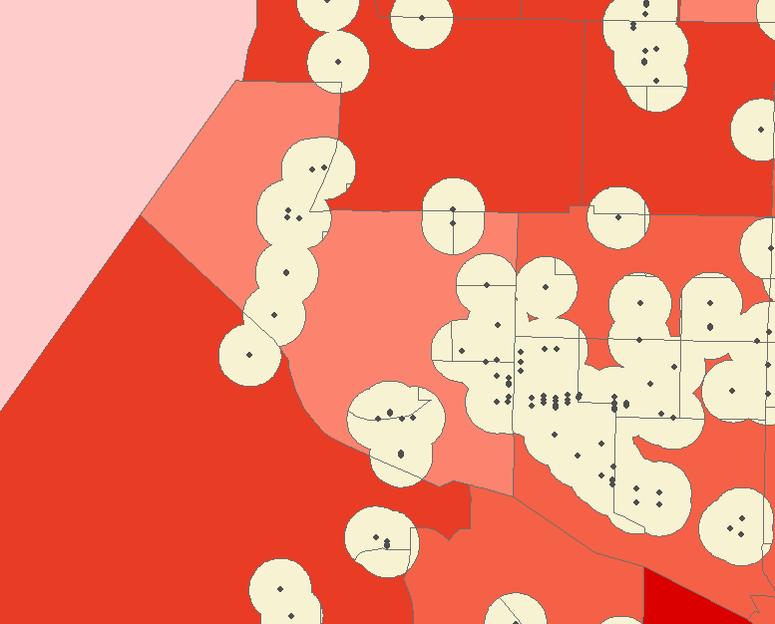
Aggregated to census tract level/city level

Slide 18
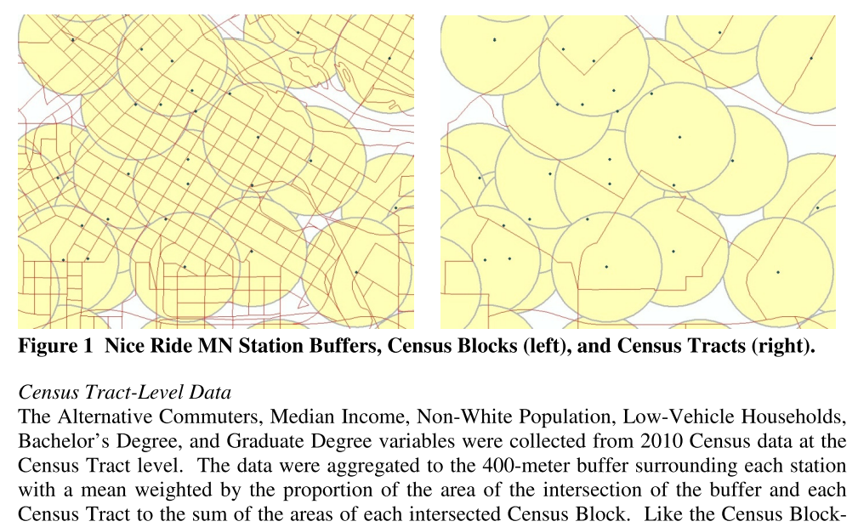
Rixey, R. "Station-level forecasting of bikesharing ridership: Station Network Effects in Three US Systems." Transportation Research Record: Journal of the Transportation Research Board 2387 (2013): 46-55. http://docs.trb.org/prp/13-1862.pdf

Slide 19
Evaluating Equity
 | white | black | ave_income /hh | Median car /hh | No car /hh | Age 65+ | >College Degree | <High school | Population | HH_cnt
in | 0.6809 | 0.0728 | 99777.4303 | 1.5531 | 0.2502 | 0.1092 | 0.5644 | 0.0539 | 227280.71 | 118507
out | 0.6457 | 0.0928 | 118764.33 | 1.9543 | 0.1189 | 0.1386 | 0.5141 | 0.0738 | 453218.29 | 200820
total | 0.6586 | 0.0862 | 112171.0000 | 1.8000 | 0.1693 | 0.1275 | 0.5331 | 0.0669 | 680499.00 | 319327
In = descriptive statistics for those areas “covered” by a bike
Out = descriptive statistics for those areas “not covered” by a bike
Goal: Compare these statistics to evaluate equity of availability, for different demographics

Slide 20
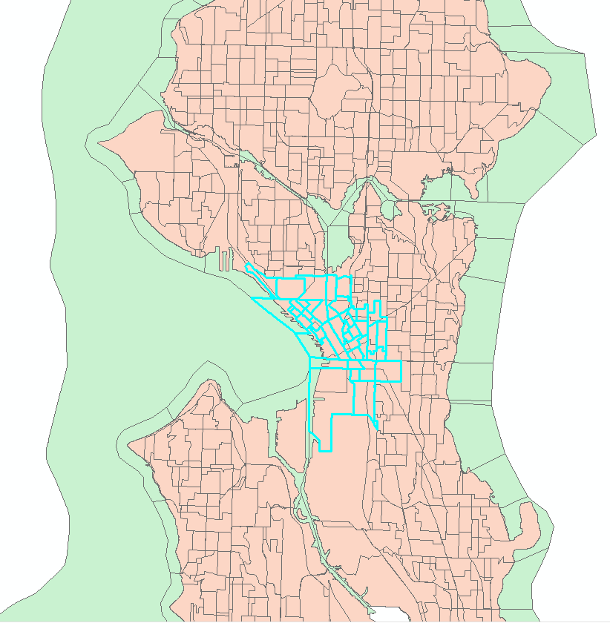
Equity - Downtown
Downtown population: 8.8%
U-district population: 6.3%
Downtown population:
more diverse, lower income, fewer cars, fewer college degree
 | white | black | ave_income /hh | Median car /hh | No car /hh
downtown | 0.5878 | 0.1221 | 90156.8348 | 1.0893 | 0.4524
Udist | 0.6551 | 0.0247 | 85282.0321 | 1.5281 | 0.2860
Seattle | 0.6586 | 0.0862 | 112171.0000 | 1.8000 | 0.1693
 | Age 65+ | >College Degree | <High school | Population | HH_cnt
downtown | 0.1426 | 0.4874 | 0.1014 | 60357 | 37216
Udist | 0.0546 | 0.6143 | 0.0261 | 43128 | 16030
total | 0.1275 | 0.5331 | 0.0669 | 680499 | 319327

Slide 21
Equity- downtown
2017-10-01 – 2018-04-31
City-wide
 | white | black | ave_income /hh | Median car /hh | No car /hh | Age 65+ | >College Degree | <High school | Population | HH_cnt
in | 0.6769 | 0.0753 | 100154.877 | 1.5288 | 0.2592 | 0.1055 | 0.5665 | 0.0556 | 235018 | 122594
out | 0.6479 | 0.0919 | 119423.391 | 1.9656 | 0.1150 | 0.1390 | 0.5148 | 0.0731 | 445481 | 196733
total | 0.6586 | 0.0862 | 112171.000 | 1.8000 | 0.1693 | 0.1275 | 0.5331 | 0.0669 | 680499 | 319327
Downtown only
 | white | black | ave_income /hh | Median car /hh | No car /hh | Age 65+ | >College Degree | <High school | Population | HH_cnt
in | 0.6052 | 0.1124 | 92049.422 | 1.0870 | 0.4528 | 0.1367 | 0.5016 | 0.0915 | 52083 | 32883
out | 0.4767 | 0.1812 | 77661.330 | 1.1235 | 0.4411 | 0.1764 | 0.3986 | 0.1640 | 8274 | 4333
total | 0.5878 | 0.1221 | 90156.834 | 1.0893 | 0.4524 | 0.1426 | 0.4874 | 0.1014 | 60357 | 37216
Summary: visibly inequitable in terms of race, income, age, education; favors higher income;
Notes:
Visualization/ statistical tests / normalize /

Slide 22
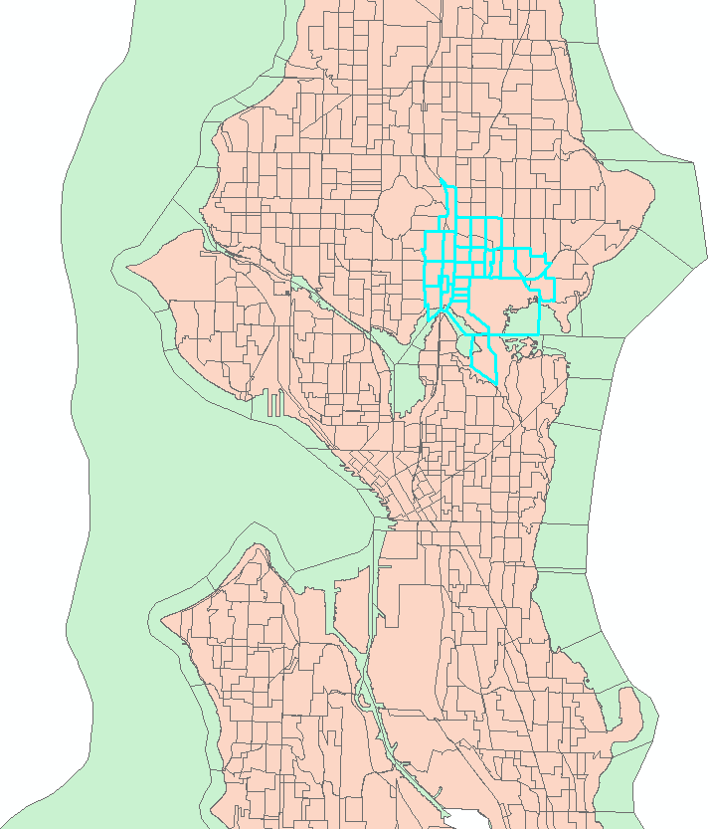
Equity – U-district
Downtown population: 8.8%
U-district population: 6.3%
U-district population:
fewer African Americans, lower income, fewer cars,
More college degree, younger
 | white | black | ave_income /hh | Median car /hh | No car /hh
downtown | 0.5878 | 0.1221 | 90156.8348 | 1.0893 | 0.4524
Udist | 0.6551 | 0.0247 | 85282.0321 | 1.5281 | 0.2860
total | 0.6586 | 0.0862 | 112171.0000 | 1.8000 | 0.1693
 | Age 65+ | >College Degree | <High school | Population | HH_cnt
downtown | 0.1426 | 0.4874 | 0.1014 | 60357 | 37216
Udist | 0.0546 | 0.6143 | 0.0261 | 43128 | 16030
total | 0.1275 | 0.5331 | 0.0669 | 680499 | 319327

Slide 23
Equity – U-district
2017-10-01 – 2018-04-31
City-wide
 | white | black | ave_income /hh | Median car /hh | No car /hh | Age 65+ | >College Degree | <High school | Population | HH_cnt
in | 0.6769 | 0.0753 | 100154.877 | 1.5288 | 0.2592 | 0.1055 | 0.5665 | 0.0556 | 235018 | 122594
out | 0.6479 | 0.0919 | 119423.391 | 1.9656 | 0.1150 | 0.1390 | 0.5148 | 0.0731 | 445481 | 196733
total | 0.6586 | 0.0862 | 112171.000 | 1.8000 | 0.1693 | 0.1275 | 0.5331 | 0.0669 | 680499 | 319327
U-district only
 | white | black | ave_income /hh | Median car /hh | No car /hh | Age 65+ | >College Degree | <High school | Population | HH_cnt
in | 0.6303 | 0.0261 | 71808.469 | 1.4327 | 0.3218 | 0.0485 | 0.6013 | 0.0274 | 34278 | 12821
out | 0.7494 | 0.0190 | 139868.90 | 1.9110 | 0.1429 | 0.0777 | 0.6638 | 0.0206 | 8850 | 3209
total | 0.6551 | 0.0247 | 85282.032 | 1.5281 | 0.2860 | 0.0546 | 0.6143 | 0.0261 | 43128 | 16030
Summary: Inverse inequity in race, income, and education; inequity in terms of age, car.
Notes:
Need to investigate U-dist in a smaller spatial range.

Slide 24
Equity – exclude downtown and U-district
2017-10-01 – 2018-04-31
City-wide
 | white | black | ave_income /hh | Median car /hh | No car /hh | Age 65+ | >College Degree | <High school | Population | HH_cnt
in | 0.6769 | 0.0753 | 100154.877 | 1.5288 | 0.2592 | 0.1055 | 0.5665 | 0.0556 | 235018 | 122594
out | 0.6479 | 0.0919 | 119423.391 | 1.9656 | 0.1150 | 0.1390 | 0.5148 | 0.0731 | 445481 | 196733
total | 0.6586 | 0.0862 | 112171.00 | 1.8000 | 0.1693 | 0.1275 | 0.5331 | 0.0669 | 680499 | 319327
City-wide: exclude downtown and u-district
 | white | black | ave_income /hh | Median car /hh | No car /hh | Age 65+ | >College Degree | <High school | Population | HH_cnt
in | 0.7144 | 0.0733 | 108431.19 | 1.7390 | 0.1633 | 0.1076 | 0.5821 | 0.0492 | 148657 | 76891
out | 0.6476 | 0.0925 | 119951.62 | 1.9864 | 0.1069 | 0.1399 | 0.5071 | 0.0745 | 431755 | 190610
total | 0.6650 | 0.0877 | 116804.97 | 1.9167 | 0.1226 | 0.1317 | 0.5266 | 0.0679 | 580412 | 267501
Summary: Compared to city-wide, increased differences in race and education.

Slide 25
Bikeshare Equity
Summary:
Seattle: Seattle as whole exhibits inequity of access to shared bikes service areas in terms of race, age, education, and # of cars. Inverse equity is observed for income.
Downtown: Compared to city-wide equity, larger differences are observed for race, age, and education. Higher income population have more access to bikeshare services than lower income population.
U-district: Inverse equity is observed for race and education. People who have access to bikeshare services have significantly lower income than those who do not.
Seattle without U-district and downtown: Similar equity pattern to city-wide statistics, but with larger differences in race and education.

Slide 26
Baselines - no auxiliary features
2017-10-01 - 2018-04-30 lime data trip starts
training: 2017-10-01 - 2018-03-30 ; test: 2018-04-01 - 2018-04-30
Use one week data to predict next hour # of trip starts
 | RMSE | MAE
previous week Average | 1.3526 | 0.3935
average of previous hour h day of week d | 1.1765 | 0.3094
previous observation | 1.1847 | 0.3218
ARIMA | 1.7042 | 0.3354
SARIMA | 1.0196 | 0.3011
LSTM | 0.9769 | 0.2962
ConvLSTM | 1.0606 | 0.2598
Notes:
try last 24 hours to predict next hour
try attention- model

Slide 27
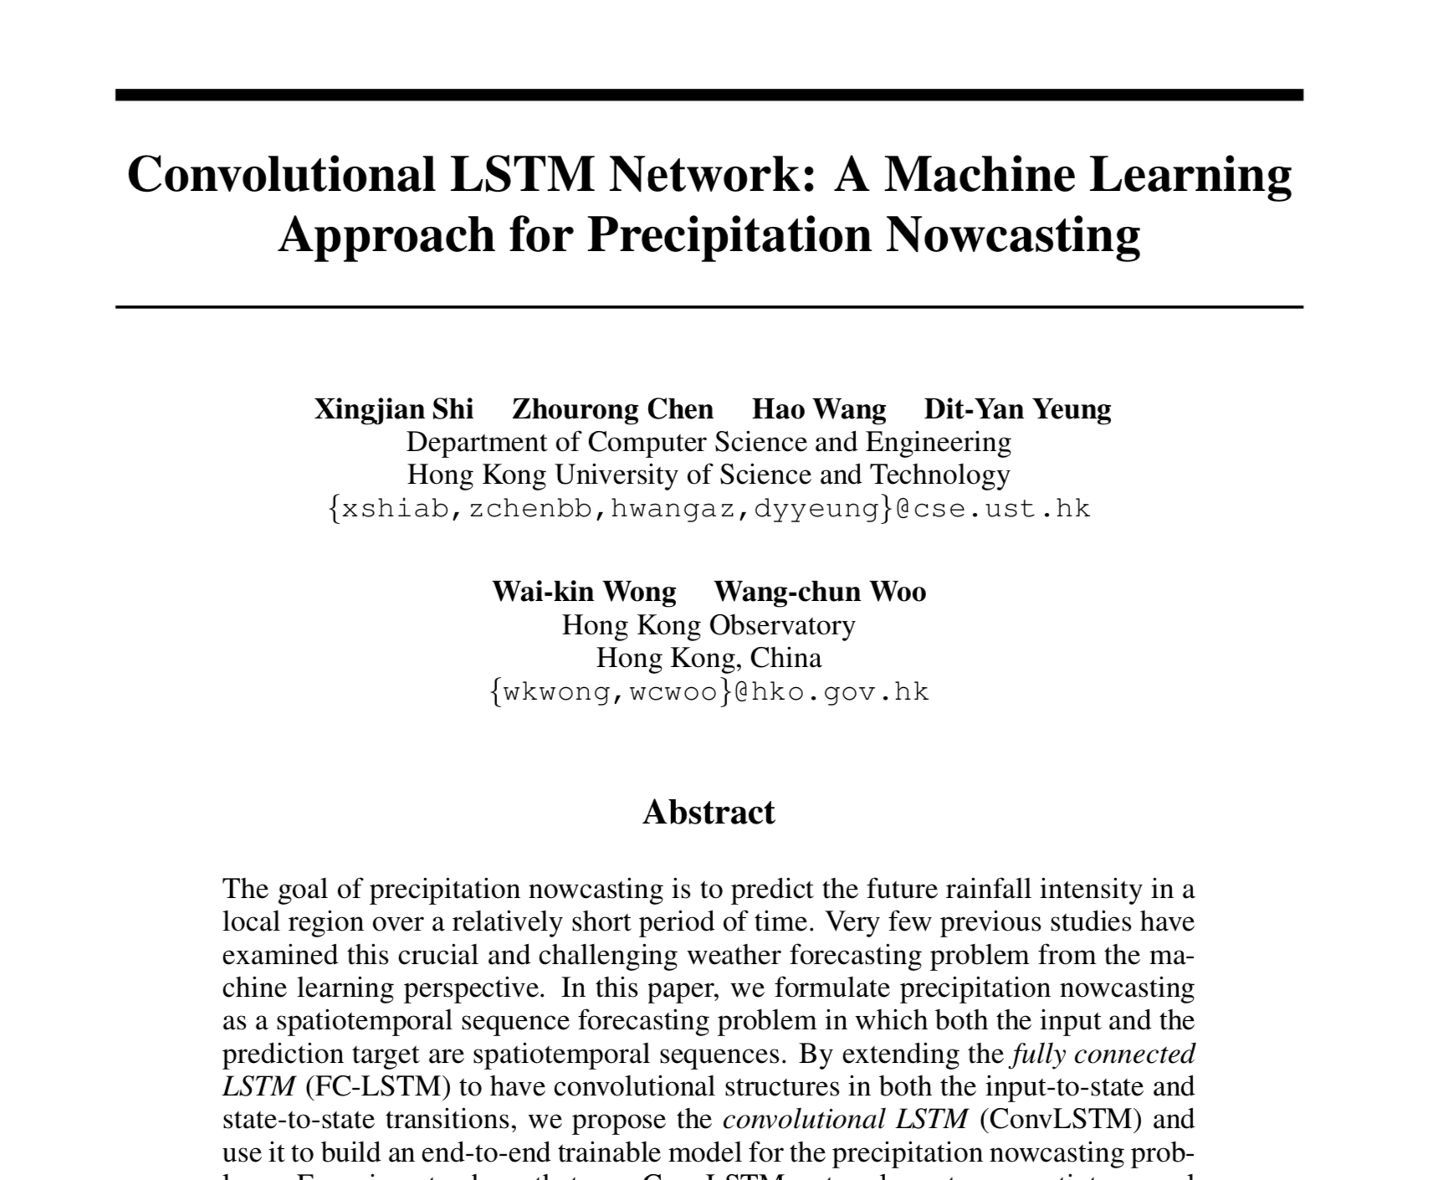

Slide 28
ConvLSTM model
Convolutional long short-term memory (ConvLSTM) model
Two key components:
Convolutional layers
Long short-term memory (LSTM) cells in recurrent neural network (RNN) model
X. Shi, Z. Chen, H. Wang, D.Y. Yeung, W.K. Wong, and W.C. Woo. Convolutional LSTM network: A machine learning approach for precipitation nowcasting. NIPS 2015.

Slide 29
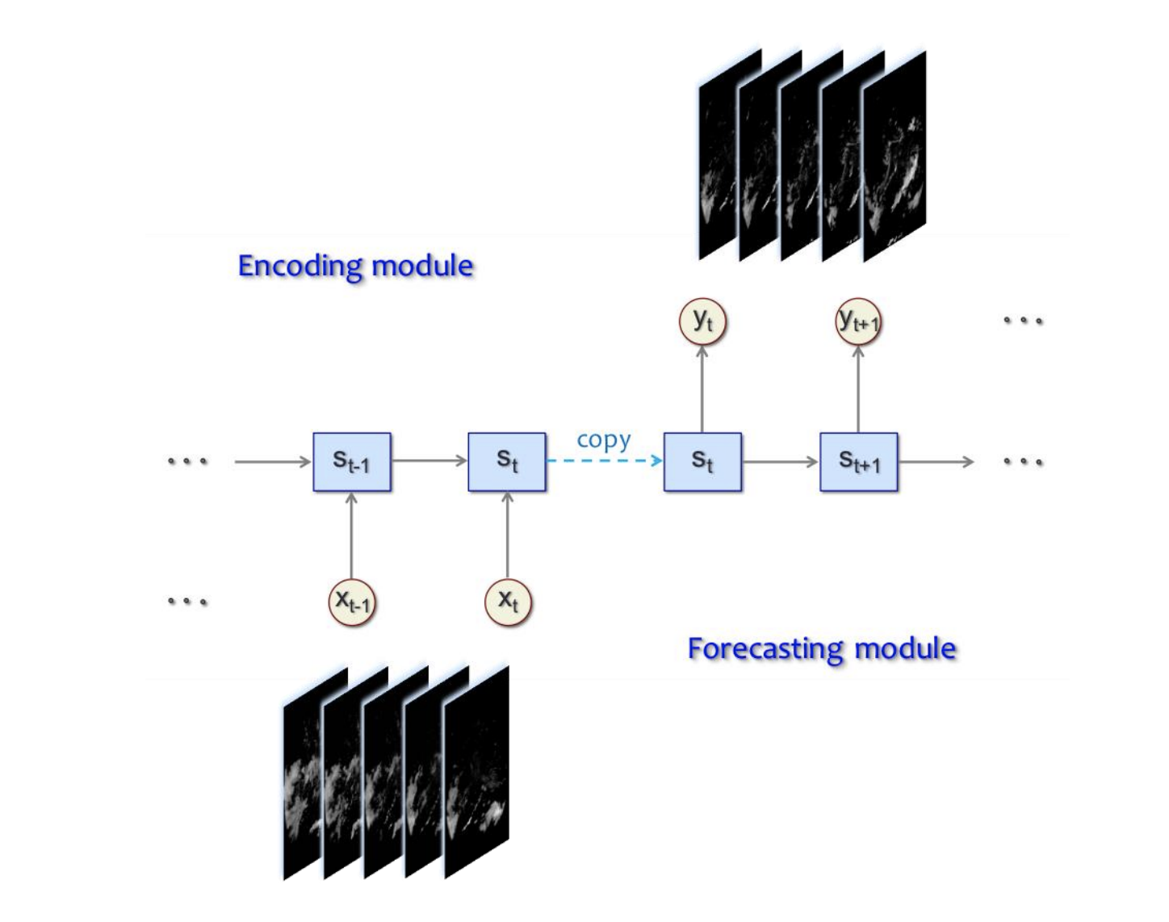
Spatiotemporal encoding-forecasting model

Slide 30
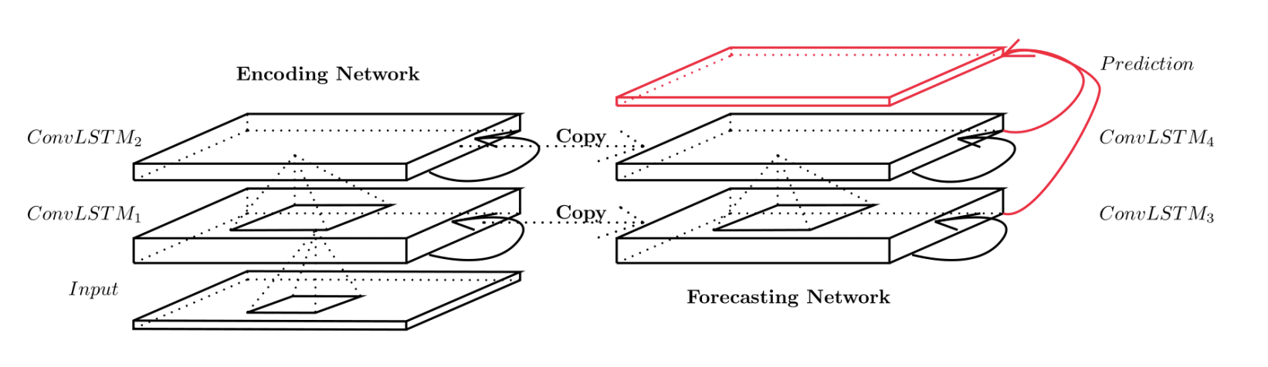
Encoding-forecasting ConvLSTM network
Last states and cell outputs of encoding network become initial states and cell outputs of forecasting network
Encoding network compresses the input sequence into a hidden state tensor
Forecasting network unfolds the hidden state tensor to make prediction

Slide 31
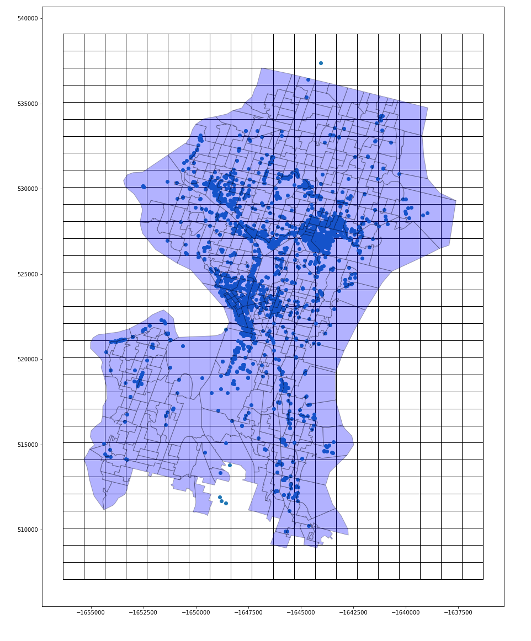
Baselines - ConvLSTM
https://arxiv.org/abs/1506.04214
https://www.tensorflow.org/api_docs/python/tf/contrib/rnn/ConvLSTMCell
Used features: [Native American Percentage, no car household, age over 65, population, poverty perc]
 | RMSE | MAE
ConvLSTM (no exogenous data) | 1.0606 | 0.2598
ConvLSTM (with demographic data - Late Fusion) | 1.0439 | 0.2536

Slide 32
Baselines
2017-10-01 - 2018-10-31 lime data trip starts
training: 2017-10-01 - 2018-08-31 ; test: 2018-09-01 - 2018-10-31： Use one week data to predict next hour # of trip starts
 | RMSE | MAE
previous week Average | 2.5102 | 0.6794
average of previous hour h day of week d | 2.1547 | 0.4838
previous observation | 1.9312 | 0.5173
ARIMA | 3.59652 | 0.5383
SARIMA | / | /
LSTM | 1.8314 | 0.4679
ConvLSTM | 1.9107 | 0.4544
ConvLSTM with 10 demographic features | 1.8630 | 0.4197
3D CNN | 1.6802 | 0.3918
3D CNN with 10 demographic features | 1.5751 | 0.3811
Notes:
try last 24 hours to predict next hour
try attention- model

Slide 33
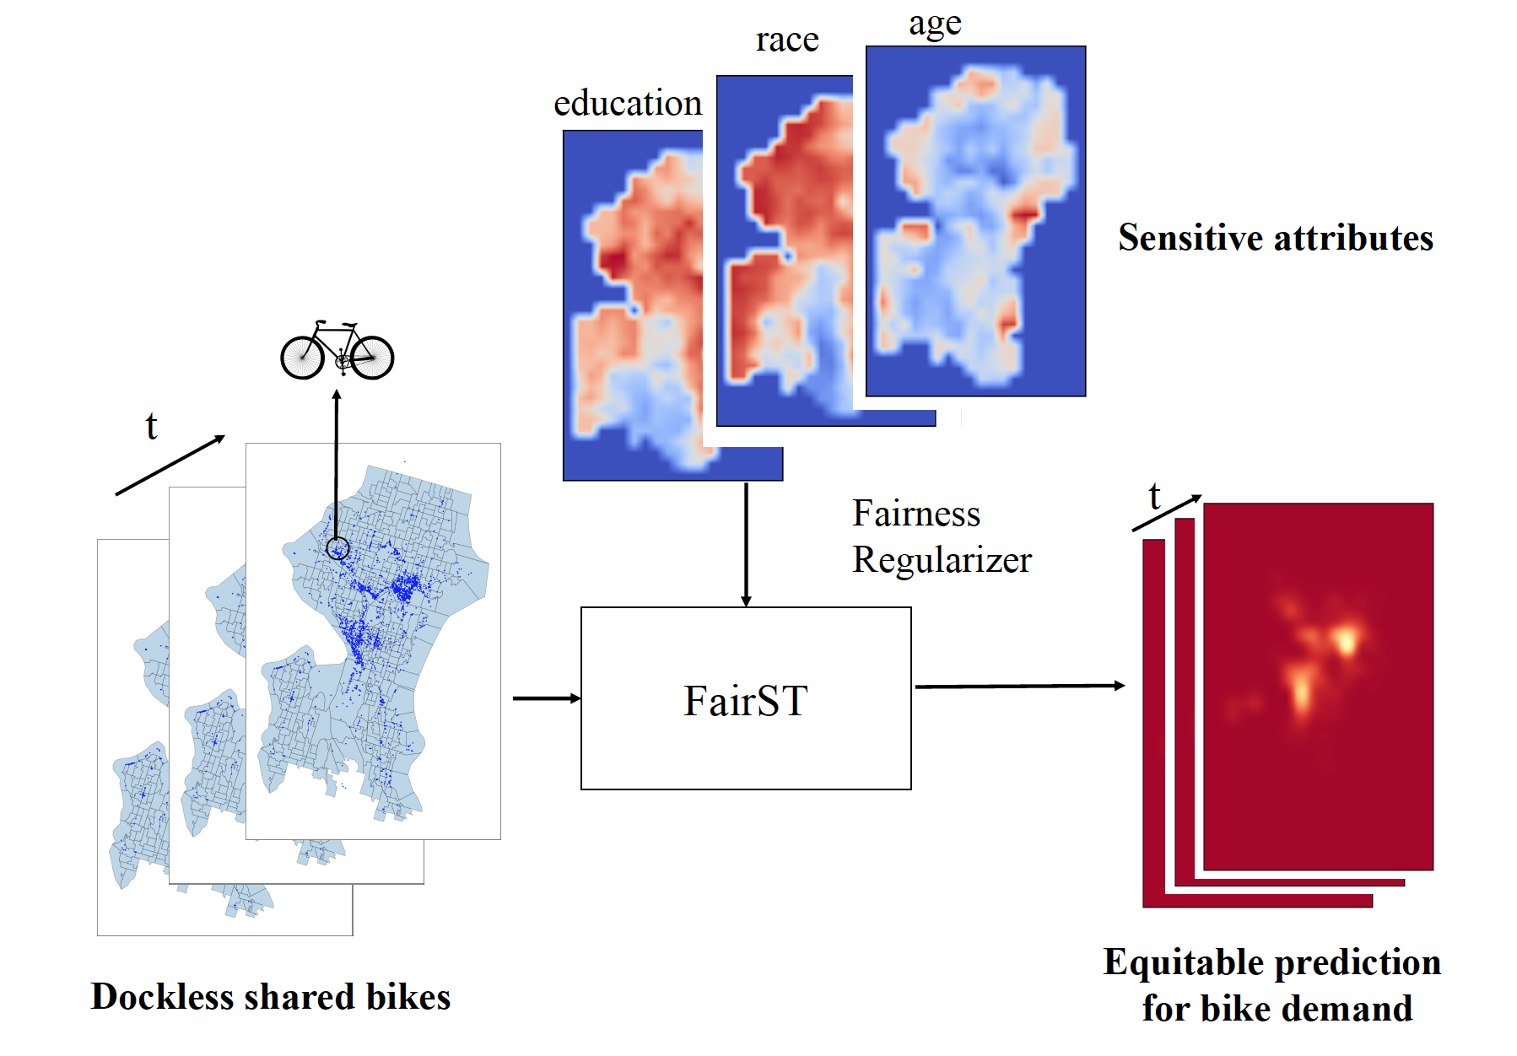
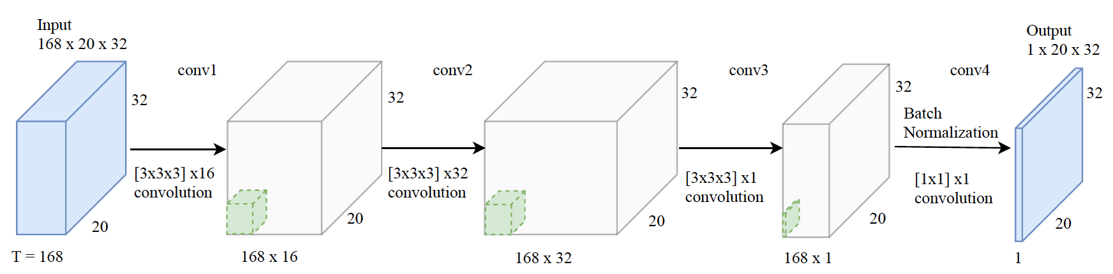
FairST: Adding Fairness to 3dCNNs

